Slide 1
DESIGN AND IMPLEMENTATION OF THUMB PROCESSOR ON FPGA
- Group Guide: Dr. R.D. Daruwala

Slide 2
WHY ARM?
The sales pitch of ARM goes something like this- “The ARM architecture has the best MIPS to Watts ratio as well as best MIPS to dollars ratio in the industry”

Slide 3
Why ARM?
3-address data processing instructions
Powerful load and store multiple register instructions
Dense 16-bit Thumb Mode
Pipelining, Superscalar
RISC Processor
Memory Management Units
Less Chip Space

Slide 4
Why Thumb Instruction Set?
Requires 70% of the space of the ARM code
40% more instructions than the ARM code
With 32-bit memory, the ARM code is 40% faster than the Thumb code
With 16-bit memory, the Thumb code is 45% faster than the ARM code
Uses 30% less external memory power than ARM

Slide 5
THUMB Features
Simple but powerful and very dense 16 bit Instruction Set
High code density
Multicycle execution of all instructions along with 5 stage pipeline architecture.

Slide 6
Thumb Processor Features
16 bit RISC processor
Load and Store Architecture
Tested at a clock frequency of 50 MHz
It has 16 bit address bus and hence can access up to 65536 memory locations
It consists of 16 general purpose registers each of 16 bit
It has 256 x 16 bits of RAM
It has 16 bit Program Counter, Stack Pointer and Link Register which are a part of general purpose registers

Slide 7
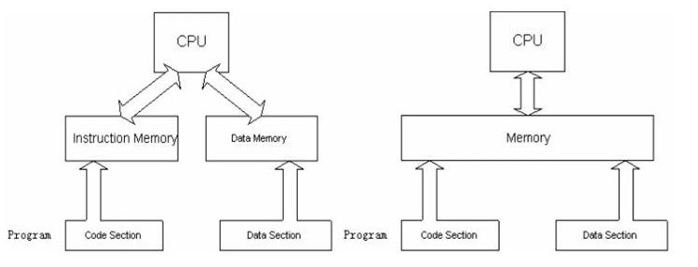
HARVARD ARCHITECTURE

Slide 8
Modified Harvard
Harvard physically separates storage and signal pathway for instructions and data
There is no such strict separation in Modified Harvard
Memory Mapping
Number of Instruction bits is greater than the number of data bits
In cases without caches, the Harvard Architecture is more efficient than von-Neumann.

Slide 9
DESIGN TASKS
Designing of block diagram of the processor
Building a datapath
Designing an Instruction Set for the processor
Synthesizing of the various components of the datapath in VHDL with the help of Xilinx ISE
RTL simulation of the components of the datapath
Generating VHDL testbench waveforms of the RTL models
Simulation and Testing of individual models using ISim Simulator

Slide 10
DESIGN TASKS
Incorporation of each model in the common top model which is our actual prototype
Prototype Simulation and Testing
Verification of the entire design
Programming the FPGA device

Slide 11
System Requirements
Language: VHDL (Very High Speed Integrated Circuit Hardware Description Language)
Software: Xilinx ISE 14.2
FPGA (Field Programmable Gate Array): Nexys-2 Digilent Spartan 3E Board.
Testbench Waveform and RTL simulation: ISIM (ISE Simulator)

Slide 12
ADDRESSING MODES
IMMEDIATE ADDRESSING
REGISTER DIRECT ADDRESSING
REGISTER INDIRECT ADDRESSING
BASE PLUS OFFSET ADDRESSING
BASE PLUS INDEX ADDRESSING
BASE PLUS SCALED INDEX ADDRESSING
STACK ADDRESSING

Slide 13
INSTRUCTION SET
The total number of instructions used in our ARM processor are 35 and each belongs to one of the following categories:
DATA TRANSFER INSTRUCTIONS
DATA PROCESSING INSTRUCTIONS
BRANCH INSTRUCTIONS
STACK RELATED INSTRUCTIONS
MISCELLANEOUS INSTRUCTIONS

Slide 14
Thumb Processor Block Diagram

Slide 15
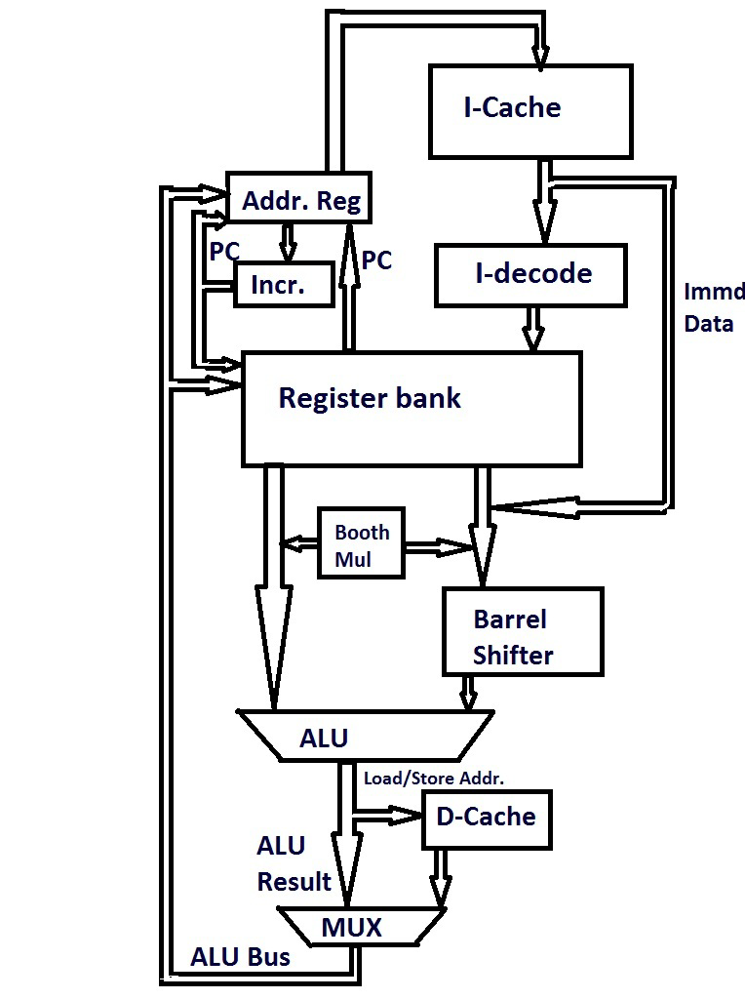

Slide 16
MODULES
INSTRUCTION QUEUE
DECODER
CONTROL UNIT
REGISTER FILE
SIGN EXTENSION BLOCK
BARREL SHIFTER
ARITHMETIC LOGIC UNIT (ALU)
CURRENT PROGRAM STATUS REGISTER (CPSR)
DATA MEMORY

Slide 17
INSTRUCTION QUEUE:
Instruction queue is used to prefetch the next instructions in a separate buffer while the processor is executing the current instruction.
With a five stage pipeline, the rate at which instructions are executed is four times that of sequential execution.
DECODER:
The 16 bit instruction from the instruction queue is given as an input to the decoder, on the basis of which it generates the necessary timing and control signals required to perform the operation specified in the instructions. The flags from PSR also form the decoder inputs.

Slide 18
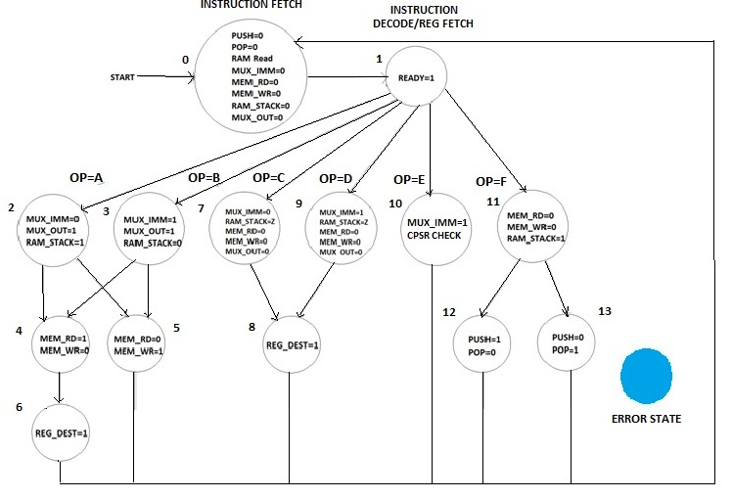
CONTROL UNIT:

Slide 19
4. REGISTER FILE :
The ARM processor has 16 registers each 16-bits wide. R0 to r12 are general purpose registers, r13 is link register, r14 is stack pointer and r15 is program counter.
SIGN EXTENSION BLOCK :
It is useful in carrying out backward jumps and for performing signed operations. if six bits are used to represent the number ”00 1010” (decimal positive 10) and the sign extend operation increases the word length to 16 bits, then the new representation is simply ”0000 0000 0000 1010”.

Slide 20
BARREL SHIFTER:
Barrel shifter is a digital circuit that can shift a data word by a specified number of bits in one clock cycle. It can implement two types of shifting, arithmetic and logical.
If a simple shifter were used, shifting by n bit positions would require n clock cycles. The length of the barrel shifter is 16 bits i.e. a maximum shift of 16 bits is possible.
ARITHMETIC LOGIC UNIT:
Arithmetic logic unit (ALU) is a digital circuit that performs integer arithmetic and logical operations. The ALU is a fundamental building block of the central processing unit of a computer.

Slide 21
CPSR: CPSR is used in user-level programs to store the condition code bits.
DATA MEMORY: The memory consists of 256 locations of 2 Bytes each. The memory is divided into 2 segments - data and stack each of 128 locations. 0 to 127 comprises of the data segment and 128 to 255 is the stack segment.

Slide 22
PORT MAP
Hierarchical model
Connects all the submodules to each other in the top module

Slide 23
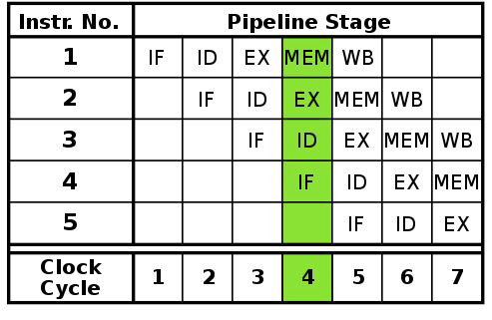
5-STAGE PIPELINE

Slide 24
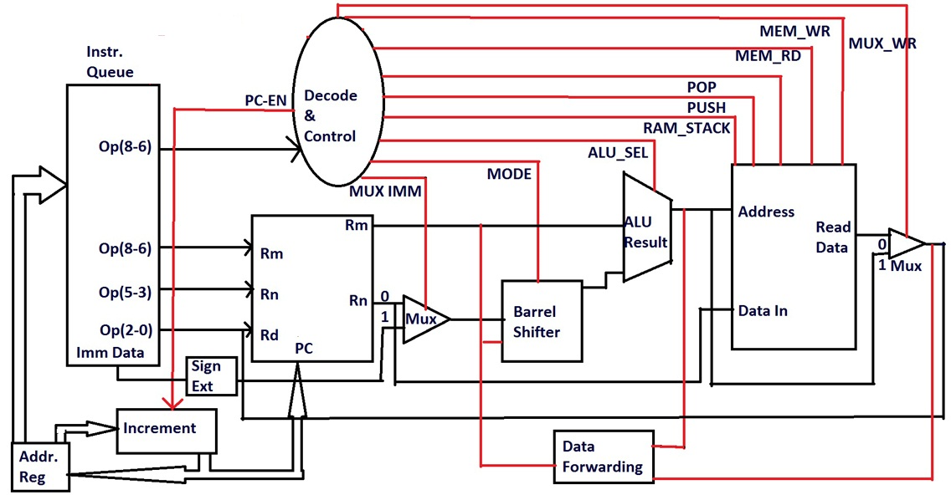
DATAPATH

Slide 25
Advantages of 5-stage pipeline
Increased Throughput.
The more pipeline stages a processor has, the more instructions it can process ”at once” and the less of a delay there is between completed instructions..
If pipelining is used, the CPU Arithmetic logic unit can be designed faster, but more complex.
Pipelining in theory increases performance over an un-pipelined core by a factor of the number of stages.
Pipelined CPUs generally work at a higher clock frequency than the RAM clock frequency, increasing computers overall performance.

Slide 26
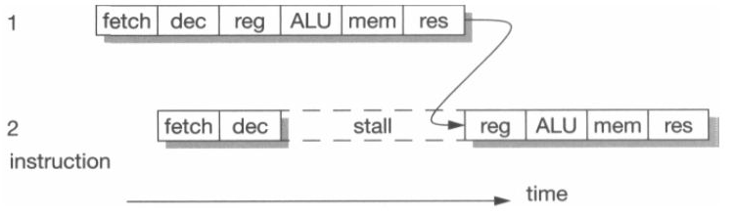
PIPELINE HAZARDS

Slide 27
PRACTICAL IMPLEMENTATION ON FPGA
Burst mode
Execution
Register selection
Display the output

Slide 28
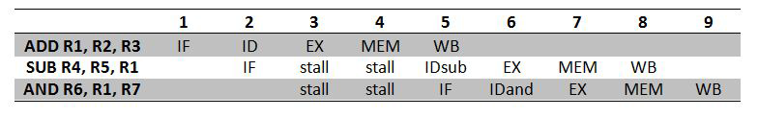
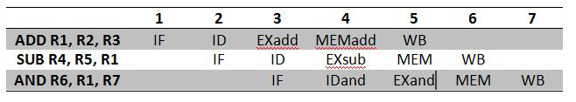
SOLUTION TO PIPELINE HAZARDS
DATA FORWARDING
Fig: Stalling in pipeline without data forwarding
Fig: Pipeline with data forwarding

Slide 29
FUTURE SCOPE
FLOATING POINT UNIT:
ARM floating point architecture can support for floating point operations in half-, single- and double-precision floating point architecture.
With the inclusion of this feature, imaging applications, body control applications, FFT and filtering in graphics can be supported.
BRANCH PREDICT UNIT:
In processors without branch predict unit, the target of the branch is not known until the end of the Execute unit.
At the Execute stage it is known whether or not the branch is taken. Branch prediction attempts to guess whether a conditional jump will be taken or not. The longer the pipeline the greater the need for a good branch predictor.

Slide 30
REFERENCES
Computer Organization And Design (ARM Edition) by Patterson & Hennessy.
ARM system On-chip architecture by Steve Furber.
ARM v7-M Architecture, Application Level Reference Manual.
vhdlguru.blogspot.com
www.stackoverflow.com
www.stackexchange.com

Slide 31
Presented By-
APURVA TAYADE
CHINMAY GADGIL
JANAKI THAKKAR
MOHNISH BHATIA
SAGAR BACHWANI
SAURABH NAIR

